Slide 1
A Bio-Inspired Biped Robot with Variable Stiffness Actuator
Name: Owee Avinash Angare
MIS: 111713005

Slide 2
Content
Introduction to Biped Robots
Literature Survey
Development in design of biped robots in past 2 decades
Methodology
Conceptual explanation and mechanical design of variable stiffness
actuator (VSA)
Case Study
Biped robot ‘Binocchio’ with VSA
Conclusion
Future scope

Slide 3
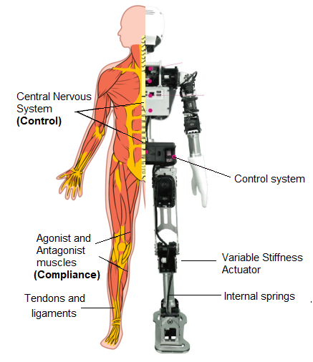
Introduction
Bio-inspired robotic locomotion
Biped robots
Traditional Biped robot design concepts
Key Terms:
1. Human Locomotion
A. Mechanics
B. Control
C. Feedback
2. Zero Moment Point
3. Passive Dynamic Walking
4. Series Elastic Actuation
Main Problem with current biped robots

Slide 4
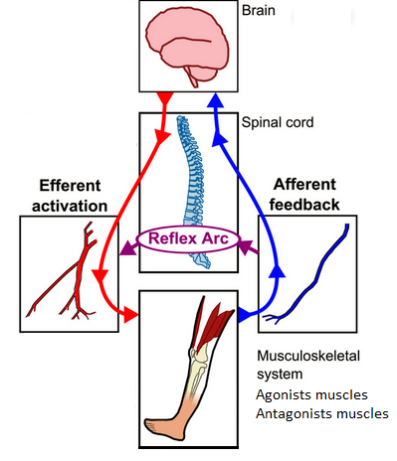
Human Locomotion
Inherent compliance
Visco-elastic property of muscles
Mechanics
Spring-mass system of leg
States of compliance
1. Motive State
2. Resistive State
3. Stabilizing State
4. Passive State
Control and Feedback
Human Locomotion

Slide 5
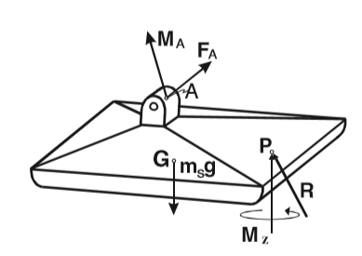
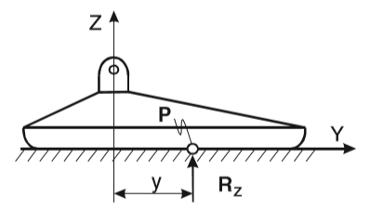
Zero Moment Point
Key aspect of human locomotion:
Dynamic Stability
Forces acting on foot when in contact
with ground
1. R_{x} and R_{y} horizontal comp of F_{A}
2. M_{Z} vertical comp. of force F_{A} and M_{A.}
3. Max acting point of force R_{z} is shifted
provides dynamic balance
No moment at point P: Zero Moment Point
Limitations
Free body diagram of foot in contact with ground
M_{Ax}
All forces replaced by only 2 forces: ZMP concept

Slide 6
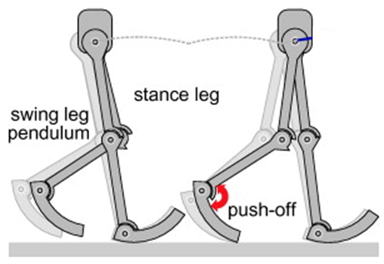
Passive Dynamic Walking
No active energy source required
during locomotion
Works on gravitational and inertial
effect
Mechanics
Swing leg pendulum
Improvement in ZMP
1. Simple Mechanism
2. Low energy cost of locomotion
Limitations
Concept of Passive Dynamic Walking

Slide 7
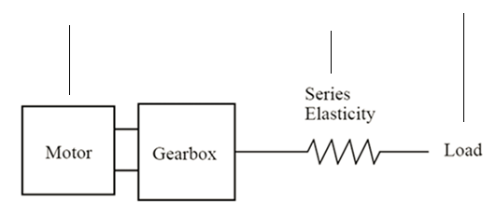
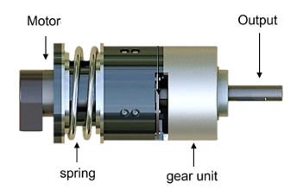
Series Elastic Actuation
First design where output force
(in turn stiffness) at joint controlled
Elastic element between motor
and load
Works on force control
1. Hooke’s law
F(out) = k * (X_{M} – X_{L})
X_{M} – X_{L} controlled by position controls
k is know. F(out) – controlled
Limitation
X_{M}
X_{L}
k
Block diagram of a Series Elastic Actuator
Conclusion: Current Problem
SEA Model

Slide 8
Literature Survey
Sr. No | Year | Author | Title | Summary
1 | 1984 | Vukobratović and Borovac | Zero-moment point- thirty five years of its life (Human Robot) | Zero Moment Point concept Applications and Limitations
2 | 1990 | McGeer | Passive dynamic walking (Robotic Res) | Mechanism, mathematics and validation of a passive dynamic walking biped robot
3 | 1996 | Farley and Gonzalez | Leg stiffness and stride frequency in human running (Biomech) | Spring-mass system of leg Compliance introduced

Slide 9
Sr. No | Year | Author | Title | Summary
4 | 1998 | Ferris, Louie and Farley | Running in the real world: Adjusting leg stiffness for different surfaces (Bio. Sci) | Role of muscles, ligaments and tendons in human running motion
5 | 2005 | Hobbelen and Wisse | Ankle joints and flat feet in dynamic walking (Berlin, Heidelberg, Springer) | Pendulum motion of swing leg Replaced the traditional arced feet by flat feet
6 | 2008 | Vanderborght, Van Ham, Verrelst, Damme, and Lefeber | Dynamic stabilization of a biped powered by pneumatic artificial muscles (Adv. Robot) | Project Lucy Artificial muscles to provide compliance

Slide 10
Sr. No | Year | Author | Title | Summary
7 | 2013 | Vanderborght, Albu-Schaeffer, Bicchi, Burdet, Caldwell and Carloni | Variable impedance actuators: a review (Robot. Auton. Syst) | Application of Series Elastic Actuator
8 | 2013 | Huang, Vanderborght, Van Ham, Wang, Damme and Guangming | Step length and velocity control of dynamic bipedal walking robot with adaptable compliant joints (IEEE/ASME) | analyze the relation between joint compliance and walking characteristics
9 | 2019 | Vanderborght, Van Ham, Verrelst, Damme, and Lefeber | A Variable Stiffness Actuator Module With Favourable Mass Distribution for a Bio-inspired Biped Robot | Solution to problems faced in traditional design Experimental validation of VSA performance Binocchio

Slide 11
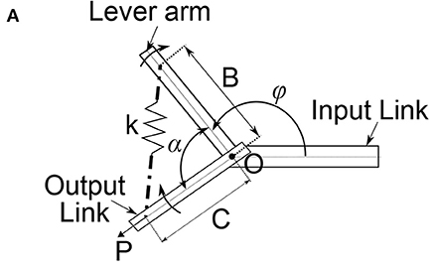
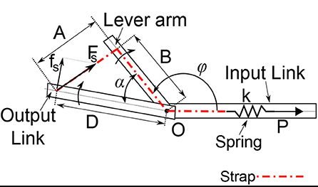
Methodology
Conceptual Explanation of a VSA
Traditional design
Spring in between Lever arm and Output link
Mechanism to drive lever arm and to
pre-compress spring on different links
New design
Spring housed in input link
Both mechanisms in one link
Working & Mathematical explanation
T = T (α, p) = D⋅f_{s}
T = k*p(t)* B*D* sin(α) ….(f_{s} = k*p(t))
A(α)
S = dT (Nm/deg)
dα
Stiffness directly proportional to k
Traditional conceptual design of a VSA
Traditional conceptual design of a VSA

Slide 12
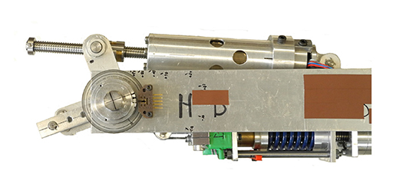
Mechanical Design of VSA
VSA design mainly consists of:
1. Driving mechanism
2. Stiffening mechanism
Driving Mechanism
1. Defines position of lever arm
Stiffening Mechanism
1. Detects deviation in angle
between output link and lever
arm
2. Adjusts compliance at output link
Driving Mechanism
Stiffening Mechanism
Complete assembly of a variable stiffness actuator

Slide 13
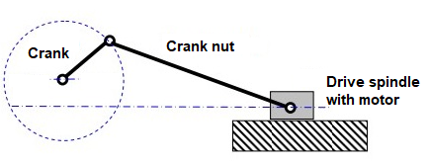
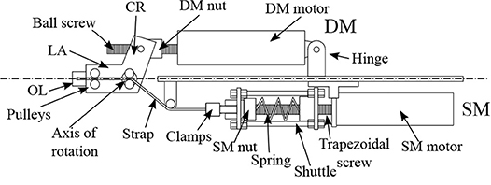
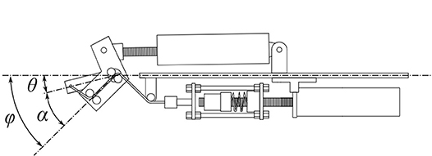
Driving Mechanism of VSA
Mechanism:
1. Joint in equilibrium position
α = 0
2. Spindle drive rotates Crank nut
translates
3. L changes rotation of crank
4. Lever arm receives torque
5. Angle between lever arm and
output link = some α
Degree of freedom to the joint
Rotates lever arm and output link
to desired position
L
Slider-Crank Mechanism
Actuated joint in equilibrium position
Angle between lever arm and output link (α)

Slide 14
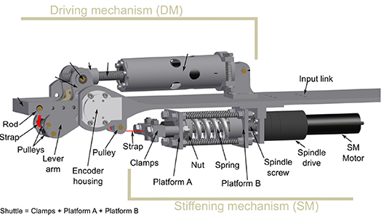
Stiffening Mechanism of VSA
Mechanism:
1. Strap - output link – lever arm
- input link.
2. Strap – Platform A
Spring – Platform B
3. Crank and lever arm rotate
shuttle compresses spring
4. Torque at output link
5. Pre-compression of spring –
control
Stiffness of joint depends on
stiffness k
Stiffening Mechanism of VSA

Slide 15
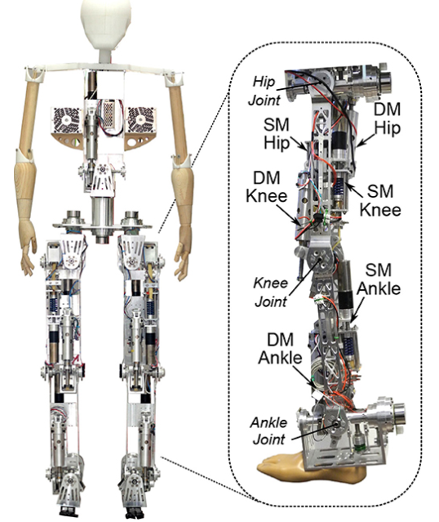
Case Study
Mechanical Structure
Properties of VSA components
Experimental Analysis
Binocchio

Slide 16
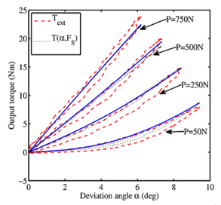
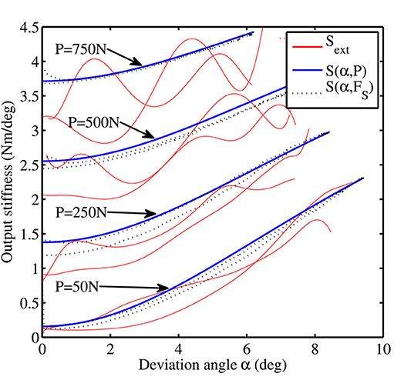
Experiment results
T_{out} v/s angle α
Stiffness_{out} v/s angle α
Stiffness increases with T_{out} and α
Comparison – Theoretical and actual values of T_{out}
Only 6.1% error

Slide 17
Conclusion
Future Scope
Thank You!

